Slide 1
Online Role-based training resources: Microsoft Learn https://docs.microsoft.com/en-us/learn/

Slide 2
M02: Prepare Data in Power BI
Author name Date

Slide 3
Module Agenda
Get data from various data sources
Optimize Performance
Resolve Data Errors

Slide 4
Lesson 1: Data Analytics and Microsoft

Slide 5
Learning Objectives
You will learn the following concepts:
Getting data from various data sources
Optimizing Performance
Resolving data errors

Slide 6
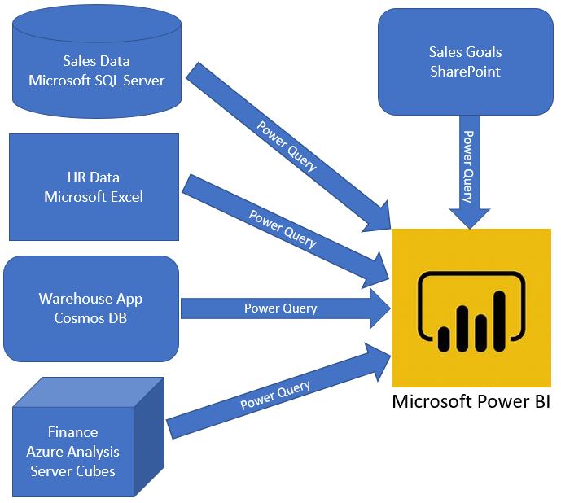
Introduction to getting data
The first step in the data analysis process is identifying and getting data.
Notes:
Like most of us, you work for a company where you are required to build Microsoft Power BI reports. The data resides in several different databases and files. These data repositories are different from each other, some are in Microsoft SQL Server, some are in Microsoft Excel, but all the data is related.
Before you can create reports, you must first extract data from the various data sources. Interacting with SQL Server is different from Excel, so you should learn the nuances of both systems. After you’ve learned the particulars of each system, you can use Power Query (the query engine used by Power BI and Excel) to help you clean the data, such as renaming columns, replacing values, removing errors, and combining query results.
After the data has been cleaned and organized, you are ready to build reports in Power BI. Finally, you will publish your combined dataset and reports to Power BI service (PBIS). From there, other people can use your dataset and build their own reports or they can use the reports that you’ve already built. Additionally, if someone else built a dataset that you'd like to use, you can build reports from that, too!

Slide 7
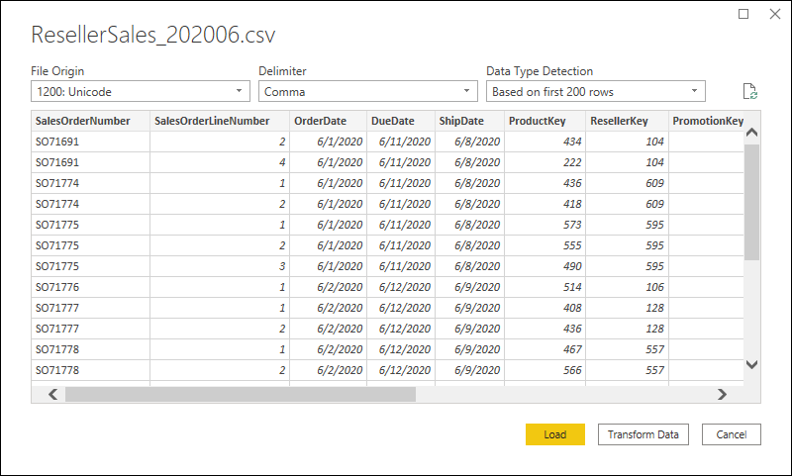
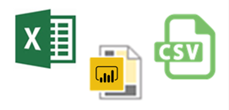
Get data from flat files
Notes:
Organizations often export and store data in files. One possible file format is a flat file. A flat file is a type of file that has only one data table and every row of data is in the same structure. The file does not contain hierarchies. Likely, you're familiar with the most common types of flat files, which are comma-separated values (.csv) files, delimited text (.txt) files, and fixed width files. Another type of file would be the output files from different applications, like Microsoft Excel workbooks (.xlsx). Power BI Desktop allows you to get data from many types of files.
Determine the location of the file: The first step is to determine which file location that you want to use to export and store your data (local, OneDrive, SharePoint).
Connect to the data file: On the Home tab, select Get data. In the list that displays, select the option that you require, such as Text/CSV or XML.
Select the data in the file to import: Select the check box(es) of the table(s) that you want to bring in to Power BI. This selection activates the Load and Transform Data buttons.
(Optional) Change the source file: You might have to change the location of a source file for a data source during development, or if a file storage location changes.
WARNING: If you are changing a file path, make sure that you reconnect to the same file with the same file structure. Any structural changes to a file, such as deleting or renaming columns in the source file, will break the reporting model.

Slide 8
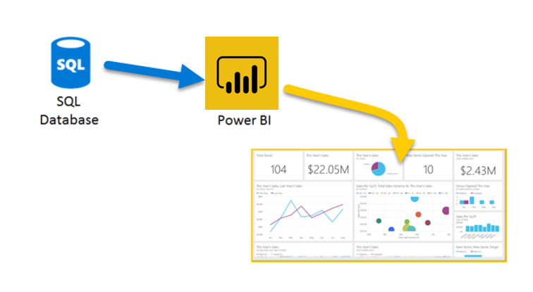
Get data from relational data sources
Notes:
If your organization uses a relational database to record its sales transactions, you can use Power BI Desktop to establish a connection to your organization's relational database, rather than getting data from individual flat files.
Connecting Power BI to your database will help you to monitor the progress of your business and identify trends, so you can forecast sales figures, plan budgets and set performance indicators and targets. Power BI Desktop can connect to many relational databases that are either in the cloud or on-premises.
Connect to the relational data store: Use Get data in Power BI Desktop and select the applicable option for your relational database.
Select the data to import: Select a table or entity to preview its contents and make sure that the correct data will be loaded into the Power BI model.
(Optional) Import data by writing a SQL Query: Another way you can import data is to write an SQL query to specify only the tables and columns that you need.
(Optional) Change data source settings: After you create a data source connection and load data into Power BI Desktop, you can return and change your connection settings at any time.

Slide 9
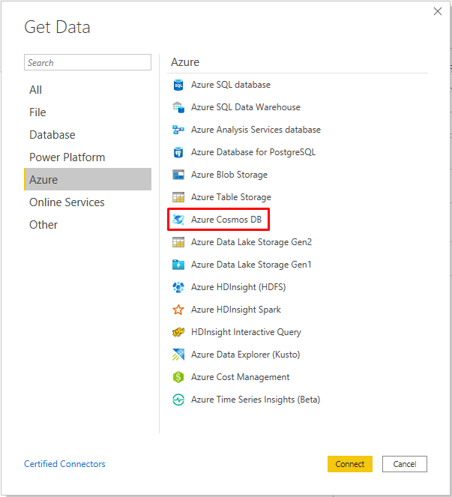
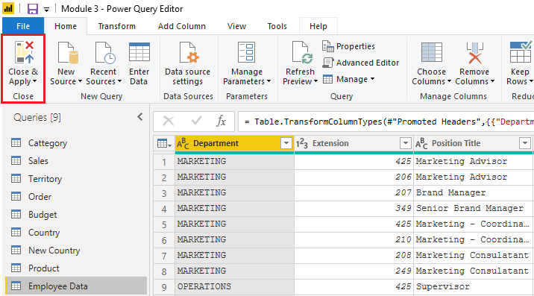
Get data from NoSQL
Notes:
Some organization don't use a relational database but instead use a NoSQL database. A NoSQL database (also referred to as non-SQL, not only SQL or non-relational) is a flexible type of database that does not use tables to store data.
Examples include Azure CosmosDB, Azure Blob/Table storage, MongoDB.
With Power BI and Power Query Editor, you can ingest NoSQL data which resembles a table with rows and columns, and relate that data to other data sources.
Connect to a NoSQL database: In Get Data, select the Azure category, select Azure Cosmos DB,and then select Connect.
Select the data: Select the table that you want to import. The preview pane only shows Record items because all records in the document are JSON documents and represented as a Record type in Power BI.
Review the selected data: To ensure you are satisfied with the data.
The data now resembles a table with rows and columns. Data from Cosmos DB can now be related to data from other data sources and can eventually be used in a Power BI report.

Slide 10
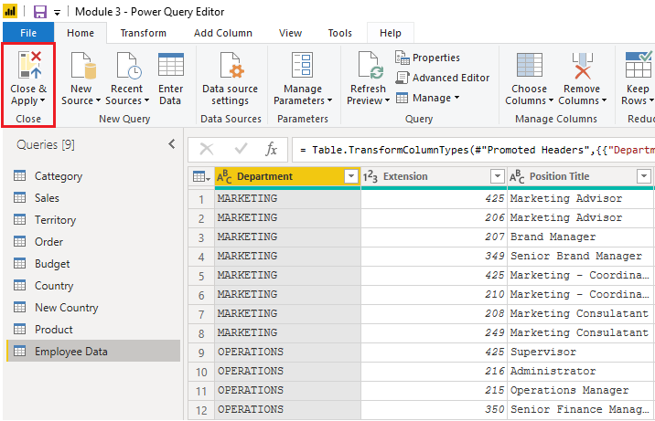
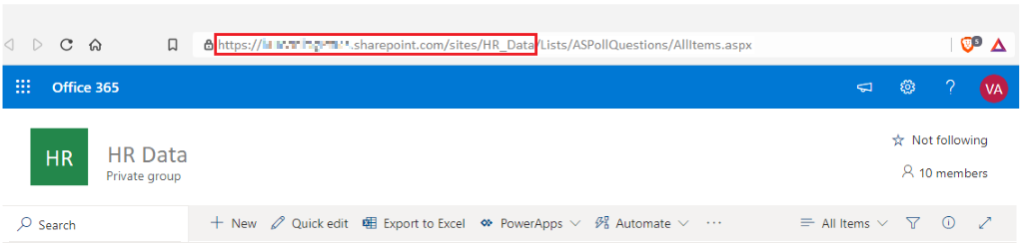
Get data from applications
Notes:
To support their daily operations, organizations frequently use a range of software applications, such as SharePoint, OneDrive, Dynamics 365, Google Analytics and so on. These applications produce their own data. Power BI can combine the data from multiple applications to produce more meaningful insights and reports.
When connecting to data in an application, you would begin in the same way as you would when connecting to the other data sources.
Connect to data in an application: Select the Get data feature in Power BI Desktop. Then, select the option that you need from the Online Services category.
Choose the application data to import: Select the list that you want to load into Power BI Desktop. Similar to when you import from other data sources, you have the option to automatically load your data into Power BI model or launch the Power Query Editor to transform your data before loading it.
When you are satisfied with your data, select the Close & Apply button to apply your changes and load your data into Power BI Desktop.

Slide 11
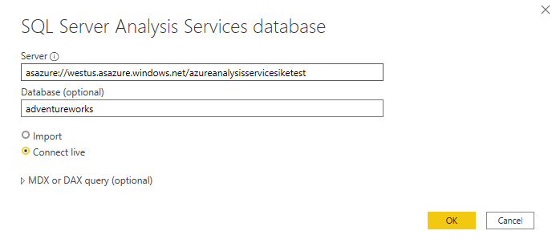
Get data from Analysis Services
An analytical data engine that lets you digest data from multiple data sources and create calculations on the fly.
Notes:
Azure Analysis Services is an Azure product that allows you to ingest data from multiple data sources, build relationships between the data, and creates calculations on the data. The calculations are built using data analysis expressions (DAX). Azure Analysis Services is similar to the data modeling and storage technology in Power BI.
Similar to a relational database, you can choose the tables that you want to use. If you want to directly query the Azure Analysis Services model, you can use DAX or MDX.
Notable differences between Azure Analysis Services cubes and SQL Server are:
Analysis Services cubes have calculations already in the cube, which will be discussed in more detail later.
If you don't need an entire table, you can query the data directly. Instead of using Transact-SQL (T-SQL) to query the data, like you would in SQL Server, you can use multi-dimensional expressions (MDX) or data analysis expressions (DAX).
You don't need to use the Get Data button in Power BI Desktop.
Getting data from AAS:
Connect to data in AAS: Use the Get data feature in Power BI Desktop. When you select Analysis Services, you are prompted for the server address and the database name with two options: Import and Connect live
Choose the tables you want to use: Similar to a relational database, you can choose the tables that you want to use. If you want to directly query the Azure Analysis Services model, you can use DAX or MDX.
Connect live is a new option in Azure Analysis Services. Azure Analysis Services uses the tabular model and DAX to build calculations, similar to Power BI.
Because you want to get data to other data in your organization , you will likely import the data directly into Power BI. An acceptable alternative is to import all other data that you want (from Excel, SQL Server, and so on) into the Azure Analysis Services model and then use a live connection. Using this approach, the data modeling and DAX measures are all performed in one place, and it's a much simpler and easier way to maintain your solution.

Slide 12
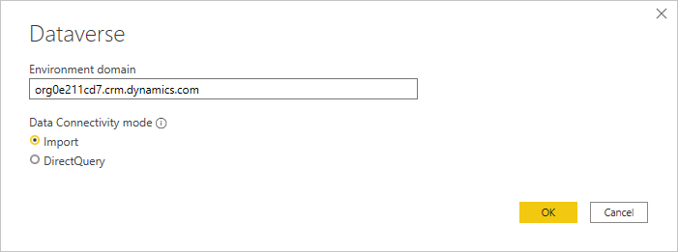
Get data from Microsoft Dataverse
A cloud-based, low-code data service and app platform, which allows you to leverage the security and connectivity of Microsoft services. Dataverse was built for powerful, scalable solutions.
Notes:
Microsoft Dataverse is a cloud-based, low-code data service and app platform, which allows you to leverage the security and connectivity of Microsoft services. Dataverse connects easily to all aspects of Microsoft Power Platform so that you can fully control, automate, and strengthen your business. With standard tables and columns, as well as the ability to easily define relationships between your data, Dataverse was built for powerful, scalable solutions.
Getting data from Microsoft Dataverse:
Connect to data in Microsoft Dataverse: Use the Get data feature in Power BI Desktop. When you select Power Platform, then Dataverse, select Connect to continue. You are prompted for the Environment domain with two options: Import and DirectQuery then select OK.
Select Sign in and then use your credentials when prompted. After you've successfully signed in, select Connect.
In the Navigator screen, enter the name of the table to locate it. Select the table by selecting the check box next to the name.
Select Transform Data to open the table in Power Query Editor.
Power Query Editor allows you to clean the data and helps make it easier for you to create charts, graphs, and other visualizations.
Because you want to get data to other data in your organization , you will likely import the data directly into Power BI. Using this approach, the data modeling and DAX measures are all performed in one place, and it's a much simpler and easier way to maintain your solution.

Slide 13
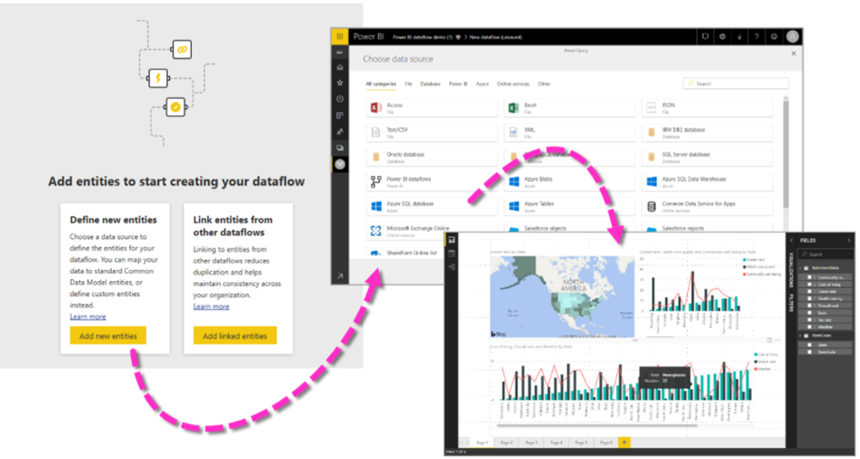
Get data from a dataflow
Notes:
A dataflow is a collection of tables that are created and managed in workspaces in the Power BI service. A table is a set of columns that are used to store data, much like a table within a database. You can add and edit tables in your dataflow, and manage data refresh schedules, directly from the workspace in which your dataflow was created.
Getting data from dataflows:
Connect to data in dataflows: Use the Get data feature in Power BI Desktop. When you select Power Platform, then dataflows, select Connect to continue.
Select Sign in and then use your credentials when prompted. After you've successfully signed in, select Connect.
In the Navigator screen, enter the name of the table to locate it. Select the table by selecting the check box next to the name.
Select Transform Data to open the table in Power Query Editor.
Power Query Editor allows you to clean the data and helps make it easier for you to create charts, graphs, and other visualizations.

Slide 14
Review Questions
Q01 – Which query language do you use to extract data from Microsoft SQL Server?
A01 – T-SQL
Q02 – You’re creating a Power BI report with data from an Azure Analysis Services Cube. When the data refreshes in the cube, you would like to see it immediately in the Power BI report. How should you connect?
A02 – Connect Live
Q03 – What can you do to improve performance when you are getting data in Power BI?
A03 – Do some calculations in the original data source.

Slide 15
Lesson 2: Optimize Performance

Slide 16
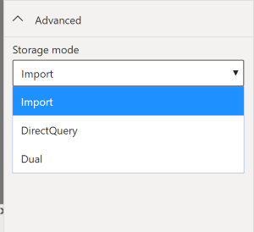
Select a Storage Mode
Specifies the storage mode of a table and lets Power BI determine how to cache data for reports.
Set the storage mode for each table individually.
Notes:
The most popular way to use data in Power BI is to import it into a Power BI dataset. Importing the data means that the data is stored in the Power BI file and gets published along with the Power BI reports. This process helps make it easier for you to interact directly with your data. However, this approach might not work for all organizations.
The three different types of storage modes you can choose from:
Import: The Import mode allows you to create a local Power BI copy of your datasets from your data source.
DirectQuery: Create a direct connection to the data source, ensuring your data is not cached and you are always viewing the most up-to-date data.
Dual (Composite): Identify some data to be directly imported and other data that must be queried.
However, sometimes there may be security requirements around your data that make it impossible to directly import a copy. Or your datasets may simply be too large and would take too long to load into Power BI, and you want to avoid creating a performance bottleneck. Power BI solves these problems by using the DirectQuery storage mode, which allows you to query the data in the data source directly and not import a copy into Power BI. DirectQuery is useful because it ensures you are always viewing the most recent version of the data.
Using the Dual mode allows Power BI to choose the most efficient form of data retrieval.
You can set the storage mode for each table individually in your model. This action enables a single dataset, which provides the following benefits:
Query performance
Data refresh optimization

Slide 17
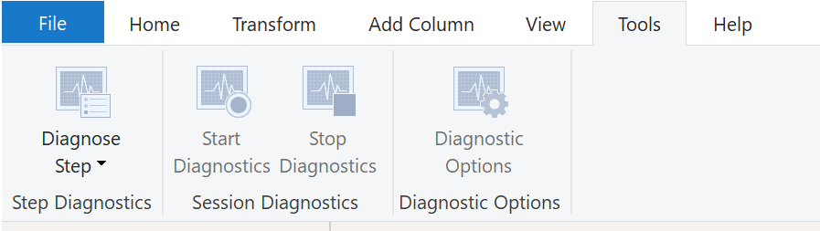
Fix Performance Issues
Notes:
Occasionally, organizations will need to address performance issues when running reports. Power BI provides the Performance Analyzer tool to help fix problems and streamline the process.
Consider the scenario where you are building reports for the Sales team in your organization. You've imported your data, which is in several tables within the Sales team's SQL database, by creating a data connection to the database through DirectQuery. When you create preliminary visuals and filters, you notice that some tables are queried faster than others, and some filters are taking longer to process compared to others.
Query diagnostics
Another tool that you can use to study query performance is query diagnostics. This feature allows you to determine what bottlenecks (if any) exist while loading and transforming your data, refreshing your data in Power Query, running SQL statements in Query Editor, and so on.
Other Techniques:
Process as much data as possible in the original data source.
Use native SQL queries.
Separate date and time, if bound together.

Slide 18
Optimize Query Performance
Performance in Power Query depends heavily on the performance at the data source.
Follow performance tuning guidelines of the source product.
Some performance tuning can be done in Power BI.
Notes:
The performance in Power Query depends on the performance at the data source level. The variety of data sources that Power Query offers is very wide, and the performance tuning techniques for each source are equally wide. For instance, if you extract data from a Microsoft SQL Server, you should follow the performance tuning guidelines for the product. Good SQL Server performance tuning techniques includes index creation, hardware upgrades, execution plan tuning, and data compression. These topics are beyond the scope here, and are covered only as an example to build familiarity with your data source and reap the benefits when using Power BI and Power Query.
Power Query takes advantage of good performance at the data source through a technique called Query Folding.

Slide 19
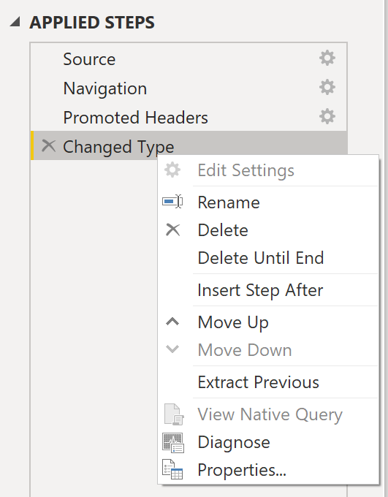
Query Folding
The process that lets Power Query generate a single query statement to retrieve and transform source data.
Notes:
The query folding within Power Query Editor helps you increase the performance of your Power BI reports. Query folding is the process by which the transformations and edits that you make in Power Query Editor are simultaneously tracked as native queries, or simple Select SQL statements, while you are actively making transformations. The reason for implementing this process is to ensure that these transformations can take place in the original data source server and do not overwhelm Power BI computing resources.
You can use Power Query to load data into Power BI. Using Power Query Editor you can then make further transformations to your data, such as renaming or deleting columns, appending, parsing, filtering, or grouping your data.
The benefits to query folding include:
More efficiency in data refreshes and incremental refreshes. When you import data tables by using query folding, Power BI is better able to allocate resources and refresh the data faster because Power BI does not have to run through each transformation locally.
Automatic compatibility with DirectQuery and Dual storage modes. All DirectQuery and Dual storage mode data sources must have the back-end server processing abilities to create a direct connection, which means that query folding is an automatic capability that you can use. If all transformations can be reduced to a single Select statement, then query folding can occur.
If the View Native Query option is not available (not displayed in bold type), that query folding is not possible for this step, and you will have to work backward in the Applied Steps area until you reach the step in which View Native Query is available (displays in bold type). This process will reveal the native query that is used to transform the dataset.
Native queries are not possible for the following transformations:
Adding an index column
Merging and appending columns of different tables with two different sources
Changing the data type of a column
Running complex DAX functions
A good guideline to remember is that if you can translate a transformation into a Select SQL statement, which includes operators and clauses such as GROUP BY, SORT BY, WHERE, UNION ALL, and JOIN, you can use query folding.

Slide 20
Review Questions
Q01 – Which storage mode leaves the data at the data source?
A01 – DirectQuery
Q02 – Which technology improves performance by generating a single query statement to retrieve and transform source data?
A02 – Query Folding

Slide 21
Lesson 3: Resolve Data Errors

Slide 22
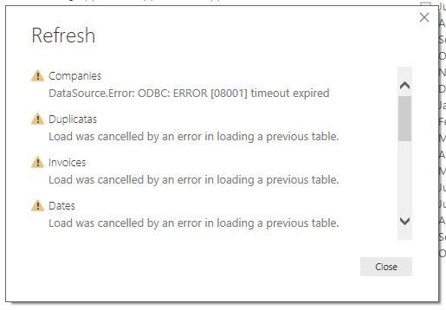
Identify and Resolve Data Import Errors
You may encounter the following errors:
Query Timeout.
Couldn’t find data formatted as a table.
Could not find file.
Data type errors.
Notes:
While importing data into Power BI, you may encounter errors resulting from factors such as:
Power BI imports from numerous data sources.
Each data source might have dozens (and sometimes hundreds) of different error messages.
Other components can cause errors, such as hard drives, networks, software services, and operating systems.
Data can often not comply with any specific schema.
Details:
Query timeout: Hardware resources are being constrained by concurrent users using the same data.
Timeout expired: Indicates that you've pulled too much data according to your organization's policies.
Couldn’t find data: Power BI expects to find data formatted as a table from Excel.
Could not find file: Caused by the file moving locations or the permissions to the file changing.
Data type errors: An error in interpreting the data type in Power BI. The resolution to this error is unique to the data source.
This list isn’t exhaustive, but shows common errors encountered.

Slide 23
Review Questions
Q01 – What type of import error might leave a column blank?
A01 – Data type error

Slide 24
Module Overview
We covered the following concepts:
Getting data from various data sources
Optimizing Performance
Resolving data errors

Slide 25
Lab: Prepare Data in Power BI Desktop
Lab: Prepare Data in Power BI Desktop

Slide 26

References
PL-300 Prepare data for analysis
https://docs.microsoft.com/en-us/learn/modules/get-data/
PL-300 Clean, Transform, and load data in Power BI
https://docs.microsoft.com/en-us/learn/modules/clean-data-power-bi/

Slide 27
Closing slide

